Slide 1
C# Professional Level 1​
Process and Memory Management

Slide 2
Chapter content
01
02
03
04
Memory : Stack & Heap
Garbage Collection
Memory usage for Value Type & Reference Type
Process & Threads

Slide 3
Memory
Stack & Heap

Slide 4
Stack
Local variables and object addresses are statically (during compile time) stored into the stack.
Objects addresses and method parameters dynamically allocated at runtime.
The storage is in LIFO (Last In, First Out) order.
Typically, a per-thread 1MB structure.
(Mainly) used for value types
Value Types /Int32, Bool, Struct, etc. …/
Pointers to Reference Types
Local variables (and parameters) usually live here
Ultra fast, very light
No garbage collection, because none is needed
All the method variables and parameters is automatically cleared at the end of the method, which include the main method.

Slide 5
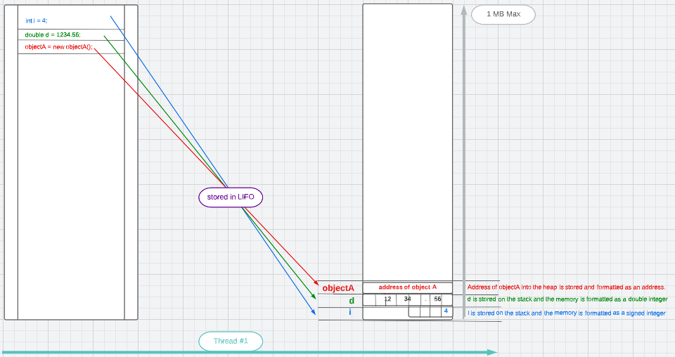
How the stack work:

Slide 6
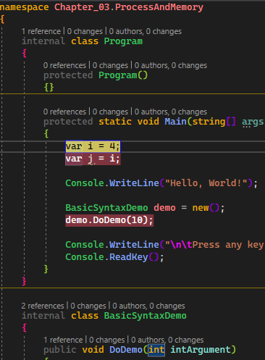
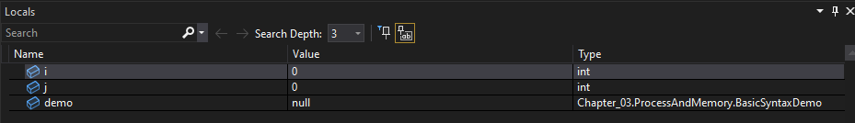
BreakPoint at var i = 4;
PreAllocated on the stack with correct size, type and name:
i → default value = 0
j → default value = 0
demo → default value = null
With default values.
Stack view inside Visual Studio

Slide 7
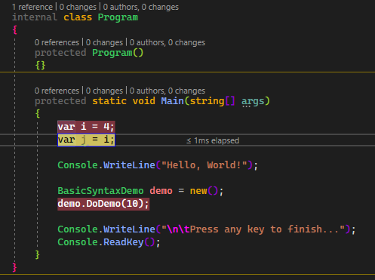
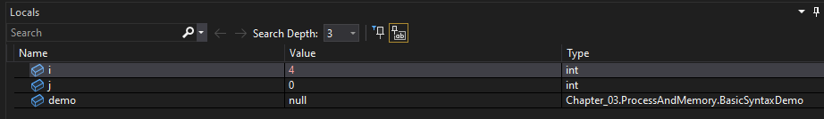
BreakPoint at var j = i;
PreAllocated on the stack with correct size, type and name:
i → default value = 4
j → default value = 0
demo → default value = null
With default values.
Stack view inside Visual Studio

Slide 8
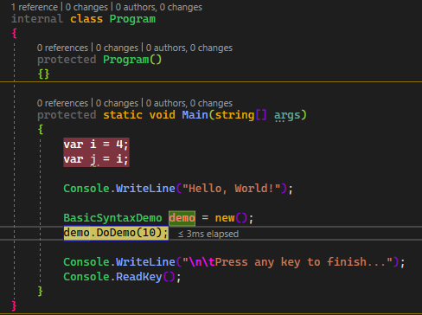
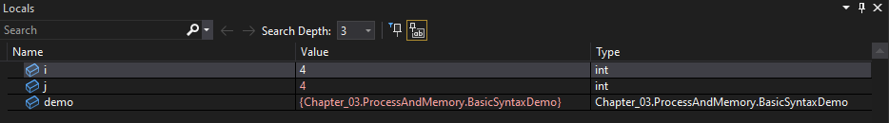
BreakPoint at demo.DoDemo(10); after object demo allocation.
PreAllocated on the stack with correct size, type and name:
i → default value = 4
j → default value = 4
demo → default value = null
With default values.
Stack view inside Visual Studio

Slide 9
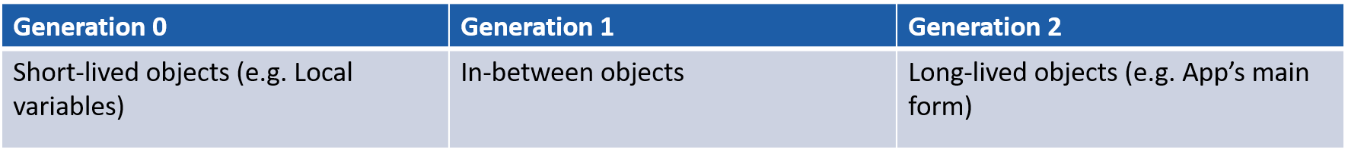
The Heap
The heap is a memory area into the global system memory.
Every program needs memory. Unfortunately, memory is finite
The heap is the result of dynamic memory allocation at runtime and can use a virtually unlimited amount of RAM.
It stores all the reference types /Object, String, Array, etc. …/
It’s not a monolith structure it is distributed between 4 heaps.
Small object heap (SOH), generation 0
Small object heap (SOH), generation 1
Small object heap (SOH), generation 2
Large object heap (LOH)
It is very fast and constantly optimized by the garbage collector
The domain of the Collector
Generations :
Promotion
Promotion
Free
Free
Free
Notes:
Expliquer rapidement le Garbage Collector.

Slide 10
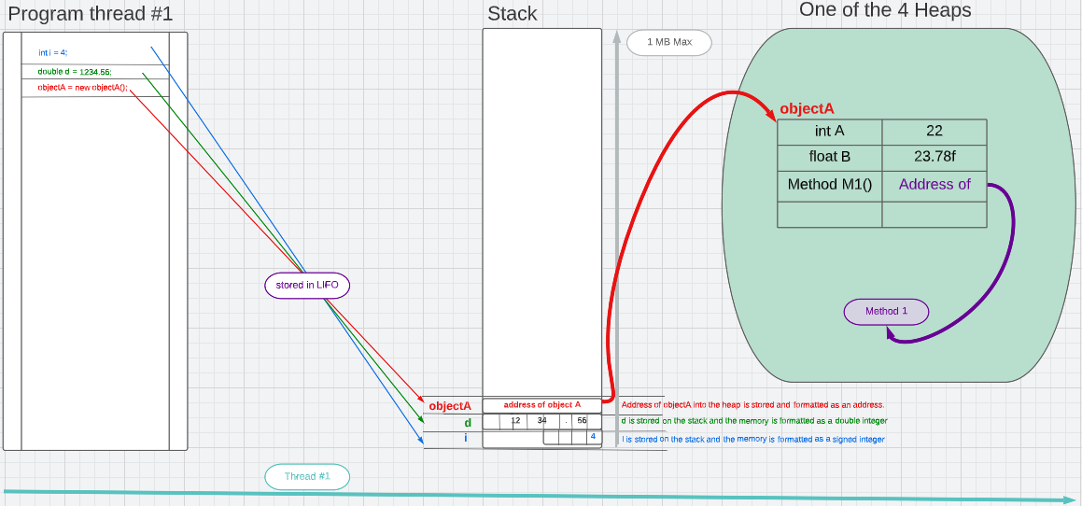
Stack and Heap working together

Slide 11
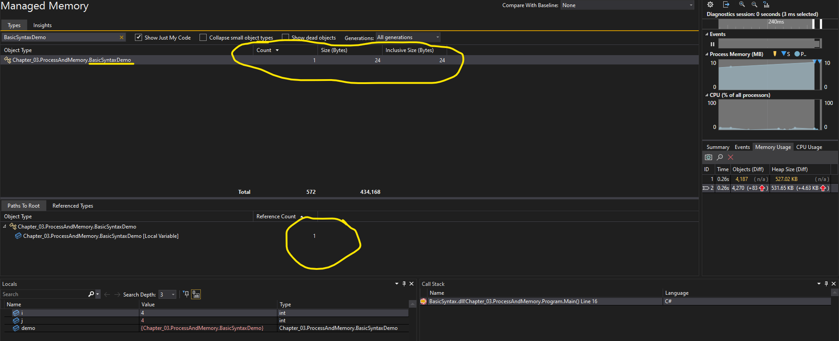
Heap view from Visual Studio during allocation

Slide 12
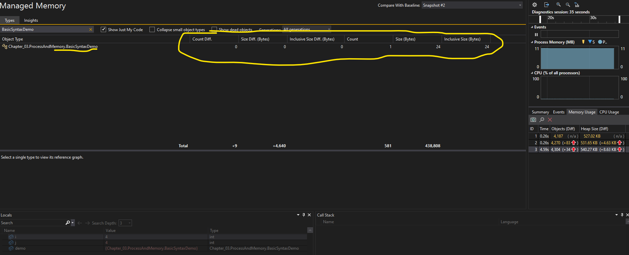
Heap view from Visual Studio after deallocation

Slide 13
Garbage Collection

Slide 14
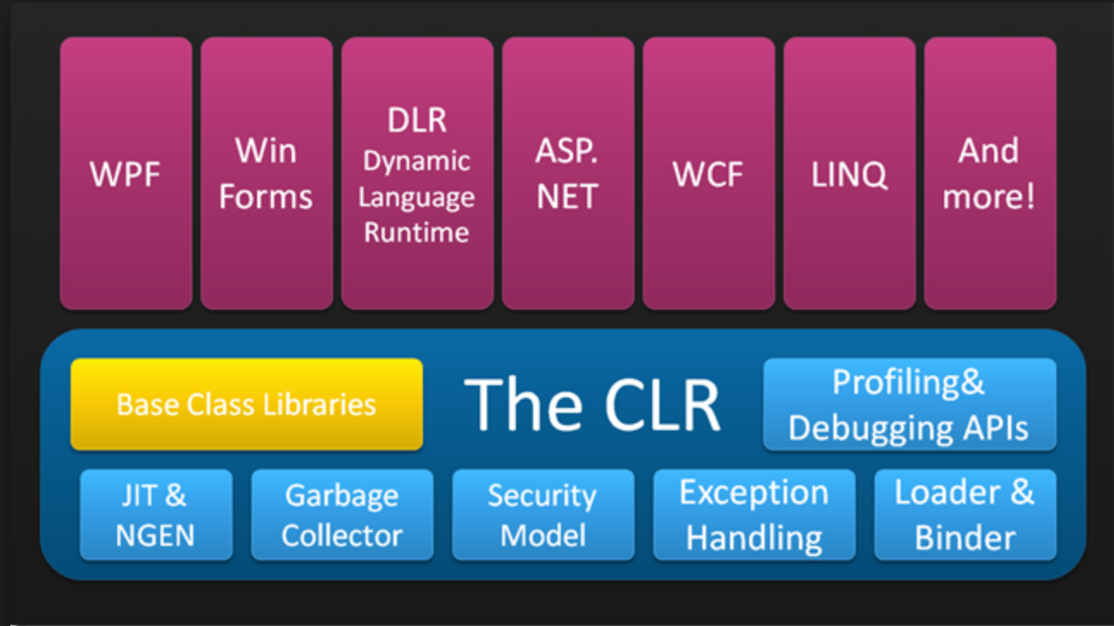
Garbage Collector
Concepts: Let’s the Framework manage memory for us!
The .NET Garbage Collector (GC) helps providing our applications with virtually unlimited memory, so we can focus on writing code instead of manually freeing up (or deallocating) memory.
Automatic Memory Management
and cleaning.
Collection (= cleaning) when:
Gen0 is Full
Induced GC /System.GC.Collect()/
System Pressure
Lives inside the CLR

Slide 15
Guidelines
DO | Use tools to profile your memory usage such as: AntsProfiler from Redgate DotTrace from Jetbrains Visual Studio Performance Profiler
DO | Analyze memory used by your application to detect potential memory leaks and performance issues
DON’T | Use GC.Collect()
DON’T | Maintain large graphs of objects in memory

Slide 16
Memory usage for Value Types
How a Value Type uses memory

Slide 17
Value Types memory usage principles
Note : Value types are described in chapter 4: C# Basics
Represent the actual Data, not a reference to it
Value Types such as local variables and method parameters are stored (allocated) in the Stack. (But maybe, also on the heap depending on context)
Memory Allocation if fixed in advance.
Don’t require Garbage collection unless they are boxed (in the heap)
Warning: when passing parameters or assigning to variable, all data is copied (imagine passing an array by value!)

Slide 18
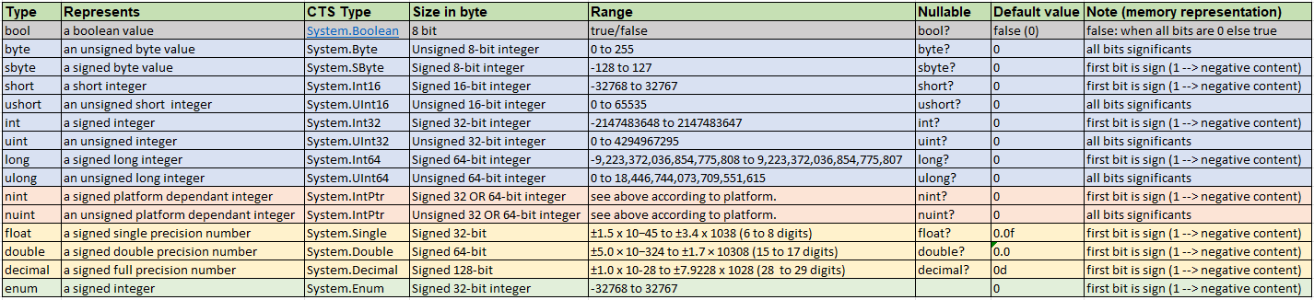
Value Types memory consumption and bits plan.
An ‘enum’ enable to work with a set of valid values or may represent numbers with names
Enums are backed on a number type (by default int, but one can specify any integral type)
Float, double and decimal formats are signed bit, mantissa and exponent.
Notes:
A type has a size (the number of bytes used to represent it) and a bit plan which gives the semantic value (e.g.: first bit positioned = signed value) or signed bit, mantissa bits and exponent bits for floats and doubles.
With a tag name (the var name meaning where it is stored in memory) , and the type (size and bit plan) all the memory can be read and write.
Enum are backed with integer values by default, but other types can be used for instance long etc. …

Slide 19
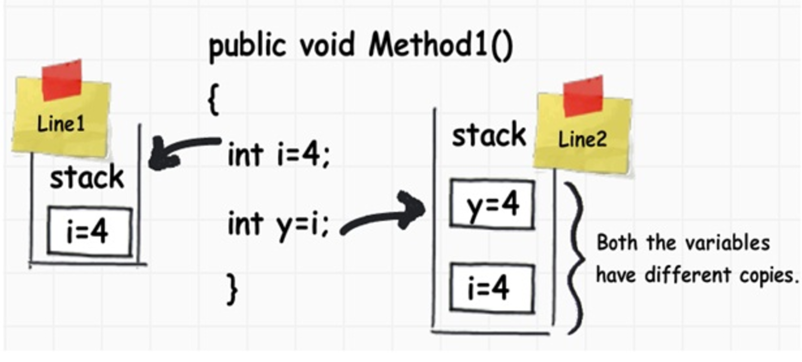
Value Types memory behavior
Value types are usually allocated on the program stack.
When we assign a value type value to another value type value, it creates a completely fresh copy

Slide 20
Memory usage for Reference Types
How a Reference Type uses memory

Slide 21
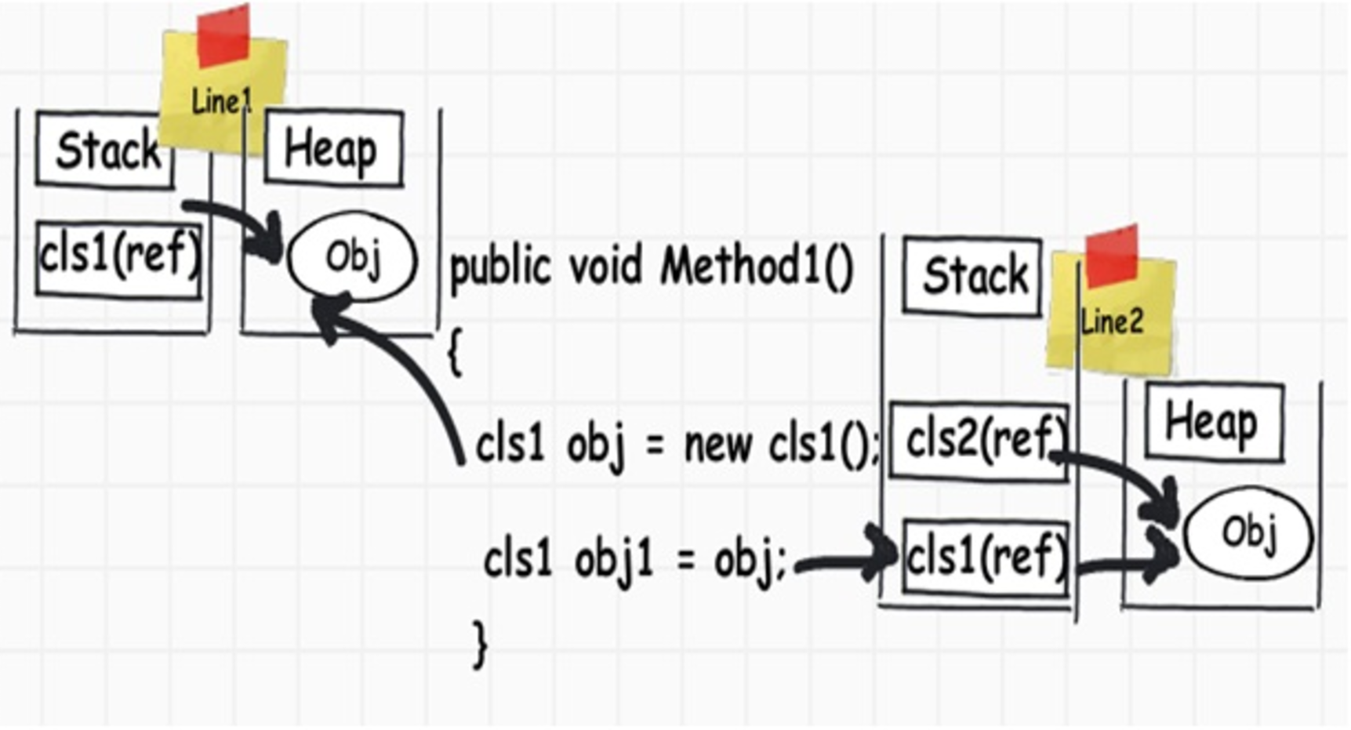
Reference Types memory behavior
When we assign a reference type to another reference type, both are pointing to the same object or data

Slide 22
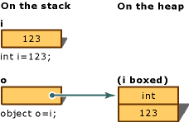
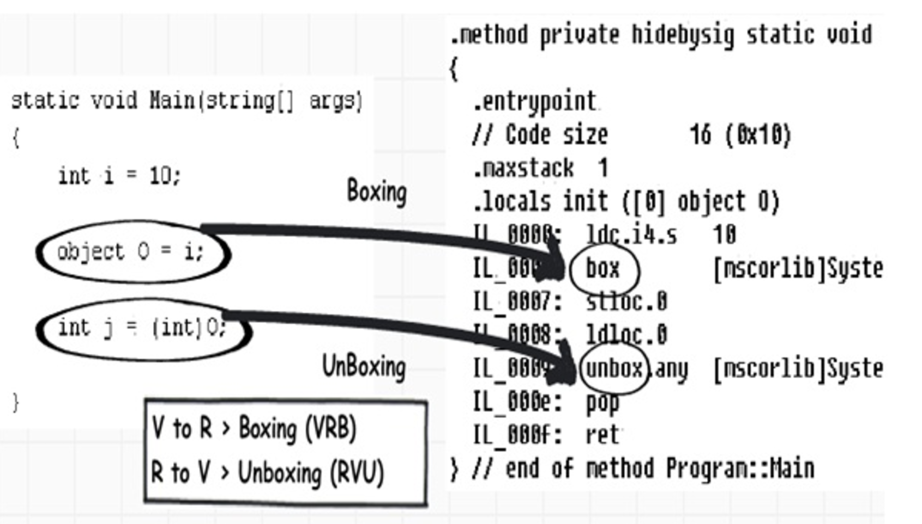
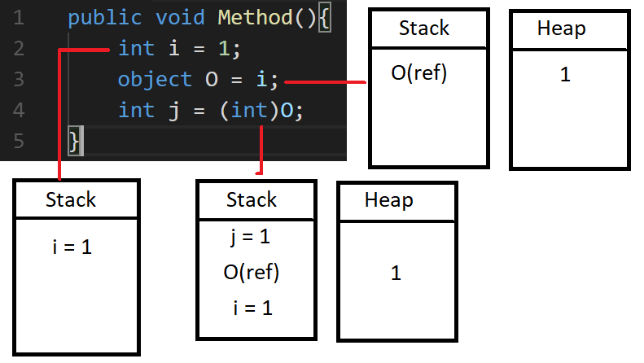
Boxing / Unboxing
Boxing is the conversion of a value type to a reference type. (i.e.: a data into an object).
This movement of data from the heap to stack and vice-versa creates a performance hit
Boxing = Cast the value and put it into an object allocated on the heap.
Unboxing = Extract the value from the object an put it on the stack.
Boxing / Unboxing operation can be viewed reading the IL Code

Slide 23
Structs vs Records vs Classes
Reference Type
Class
Struct
Record
Record/Readonly Struct
Mutable
Immutable
Value Type
Notes:
Also Exists: Record Structs

Slide 24
Guidelines
DO | Create structs instead of classes if you need « value type like » behavior (copy instead of reference). All CTS value types are structures.
DON’T | Use reference types as struct members

Slide 25
Process & Threads
Notes:
Advanced learning.

Slide 26
Process
Processes can be seen as programs or applications running into the system.
Many processes run together at any moment in the system.
A process encapsulate and isolate all the software and hardware resources which he needs to work, so many processes can run at the same time.
Represented in .Net by the class System.Diagnostics.Process
Has a unique ID
Has 1->N threads
Can do more than one thing at the time if it runs many threads at that moment.
Must be considered as an execution frame
Notes:
A voir pour les états, est ce que c’est pas trop précis pour une description de base?
Expliquer le rôle du micro-processeur pour exécuter les process et les threads.

Slide 27
Thread
A thread is an execution flow starting from one instruction and executing sequentially all instructions until the end of the thread.
So, a process has at list one thread to perform its execution.
A process can have many threads, each thread running at the same time as the others if they are not waiting or stopped.
Each thread has its own execution context and stack.
All threads share the address space of the primary execution thread.
The total number of threads should be limited because synchronization and contexts witching operations can drain the performance of the thread actions. That’s why the framework propose pre-allocated threads into thread pools.
Multi-Threading is an advanced notion and fully taken in charge by the framework.
Notes:
A voir pour les états, est ce que c’est pas trop précis pour une description de base?
Expliquer le fonctionnement et la bascule des threads du point de vue du micro-processeur et du Scheduler system.
Expliquer les avantages des multicœurs et multiprocesseurs.

Slide 28
Multithreading, why?
Mainly to avoid latency periods during process execution, taking advantage of waiting time to do other tasks instead of waiting.
Maintain a responsive interface
Multithreading optimize the use of processor time
Splitting large CPU-bound tasks to be processed simultaneously on multi process/cores machines.
Overall performance improvement
Notes:
Make care about multithreading if you target a 1vCPU environment.
In this case, mutlithreading may impact performance and should only be used to manage responsiveness / asynchronous process or optimize processor time.

